Slide 1

Customer Churn Prediction for a Streaming Service
A complete machine learning pipeline designed to predict customer churn for a fictional video streaming company. This project identifies customers most likely to cancel their subscription — empowering the business to take targeted retention actions such as personalized discounts, re-engagement emails, or tailored content recommendations.
The pipeline trains and compares multiple ML models, automatically selects the best performer, and outputs ranked churn probabilities for every customer in the dataset.
Levente Sélley, Gergő Zalaváry, Fabó Leon Tompos

Slide 2
Project Idea
Subscription-based businesses lose customers every single month — and most of those losses are preventable. By predicting which users are likely to churn before they actually cancel, companies can intervene early with targeted offers and personalized experiences.
The Business Problem
The ML Solution
The Business Output
Customer acquisition costs far exceed retention costs. Even a small reduction in monthly churn can meaningfully improve lifetime value and revenue.
This project uses behavioral and demographic features — age, subscription length, payment method, support tickets, satisfaction score, last activity, and monthly spend — to estimate churn probability per customer.
A ranked list of high-risk customers is delivered directly to the marketing team, enabling fast, data-driven retention campaigns with minimal engineering overhead.

Slide 3
Dataset
Source: Streaming Service Data — Kaggle. The dataset captures a wide range of customer attributes that serve as predictive signals for churn behavior.
Column
Description
Customer_ID
Unique identifier for each customer
Age
Customer age in years
Gender
Male or Female
Subscription_Length
Number of months the customer has been subscribed
Region
Geographic region of the customer
Payment_Method
Payment method used (e.g., credit card, PayPal)
Support_Tickets_Raised
Number of support tickets submitted by the customer
Satisfaction_Score
Customer satisfaction rating (survey-based)
Discount_Offered
Whether a discount was previously offered
Last_Activity
Days since the customer's last recorded activity
Monthly_Spend
Average monthly spending in USD
Churned
Target variable — 1 if churned, 0 if retained

Slide 4
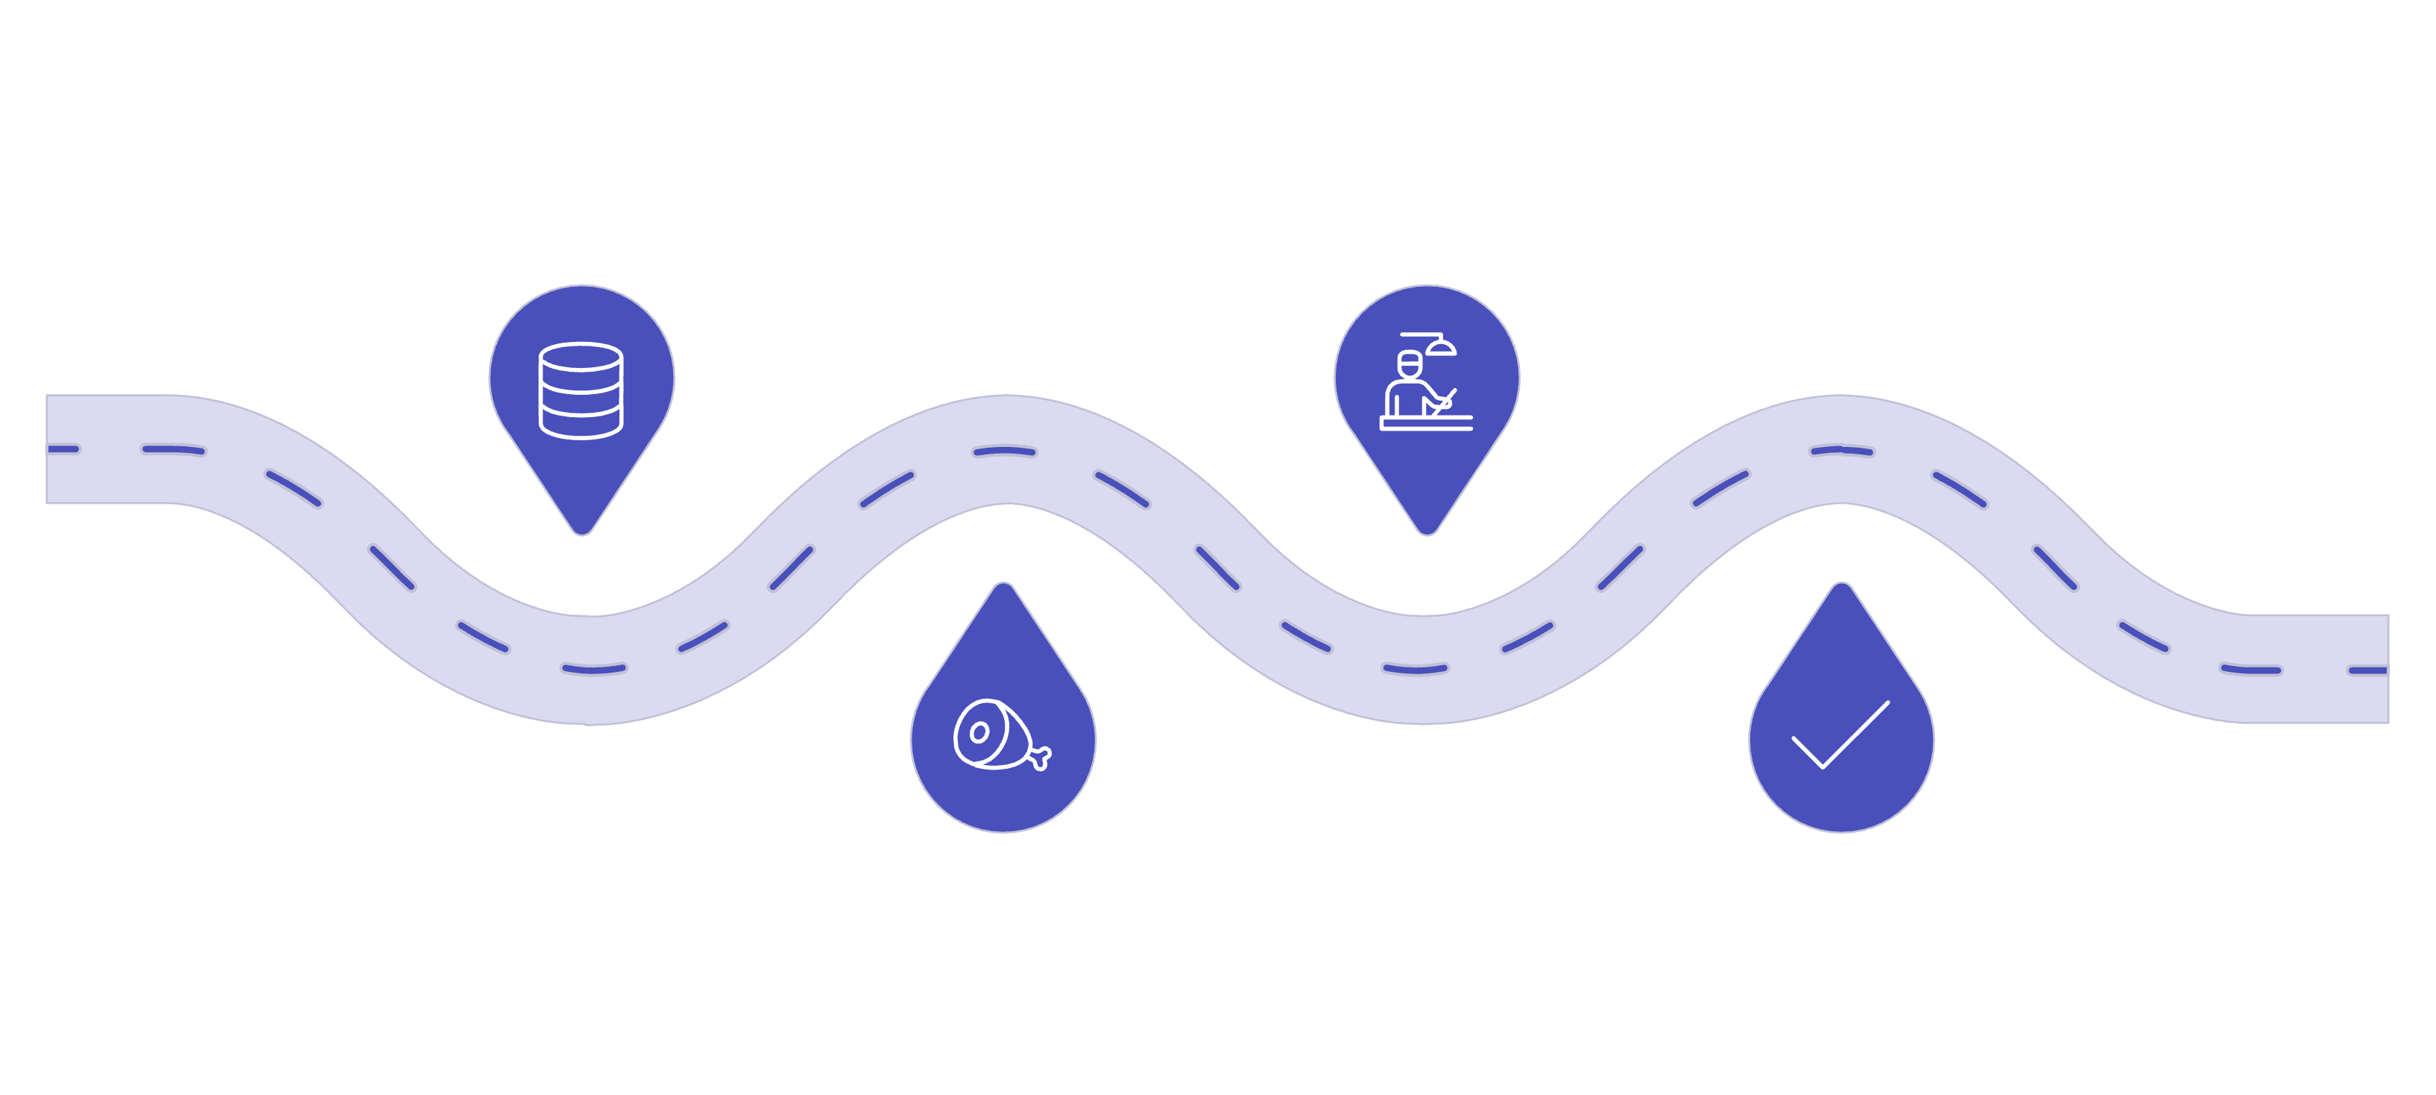




Machine Learning Approach
The pipeline follows a structured, end-to-end workflow — from raw data ingestion to ranked churn predictions. Each step is automated and reproducible.
Data Prep
Model Training
Clean, encode, and scale features
Train LR, RF, and GB models
Train/Test Split
Auto Selection
Split data 80/20 for validation
Choose model with highest accuracy
The pipeline is fully automated — no manual model selection is required. The best-performing model on the held-out test set is automatically promoted to generate the final predictions, ensuring objective and reproducible results every time the script is run.
Notes:
1. Data Preparation
Missing values are filled using the median.
Categorical variables are encoded into numerical format.
Feature scaling is applied for algorithms that require normalized input.
2. Train/Test Split
The dataset is split into training and testing sets (80/20) to evaluate model performance.
3. Model Training
Multiple models are trained and compared:
Logistic Regression
Random Forest
Gradient Boosting
4. Model Selection
The model with the highest accuracy on the test dataset is automatically selected.
5. Prediction
The selected model predicts the churn probability for each customer.
6. Feature Importance
The system calculates the most important factors influencing churn and their relative importance percentages.

Slide 5

Output: OUTPUT_PREDICTION.csv
After running the script, a structured CSV file is generated containing everything a marketing team needs to take immediate action on high-risk customers.
File Contents
Example Output Snapshot
Best model used for prediction
Overall model accuracy on test set
Top churn factors with importance percentages
All customers ranked by churn probability
Best Model Used, Random Forest
Model Accuracy, 0.84
Top Factors (importance %):
Last_Activity, 21.3%
Satisfaction_Score,18.7%
Subscription_Length,16.5%
Customer_ID, Churn_Probability
CUST000241, 0.93
CUST000982, 0.91
Customers are sorted in descending order by churn probability, allowing marketing teams to prioritize outreach starting with the highest-risk accounts first.

Slide 6
Project Structure
The repository follows a clean, minimal structure — everything needed to reproduce the full pipeline is contained in four files.
📄 Streaming.csv
🐍 ChurnPrediction.py
The raw input dataset sourced from Kaggle. Contains all customer features and the target churn label.
Main script. Runs the full ML pipeline end-to-end: data prep, model training, selection, prediction, and output generation.
📦 requirements.txt
📖 README.md
Lists all Python package dependencies. Install with pip install -r requirements.txt before running the script.
Project documentation covering setup instructions, dataset description, and output format for new contributors.

Slide 7





Possible Future Improvements
This project establishes a solid foundation. The following enhancements would elevate it from a university assignment to a production-grade churn intelligence system.
Advanced Models
Cross-Validation
Explainability (SHAP)
Incorporate XGBoost and LightGBM for significantly improved predictive performance on tabular data, especially with class imbalance.
Replace the single 80/20 split with k-fold cross-validation to produce more robust and statistically reliable model selection.
Add SHAP values to explain individual predictions — helping stakeholders understand exactly why a specific customer is flagged as high-risk.
Churn Dashboard
API or Web App Deployment
Build an interactive monitoring dashboard (e.g., with Streamlit or Dash) for real-time churn tracking and business reporting.
Deploy the trained model as a REST API (FastAPI or Flask) or web application, enabling real-time scoring integrated into CRM or marketing systems.

